Slide 1

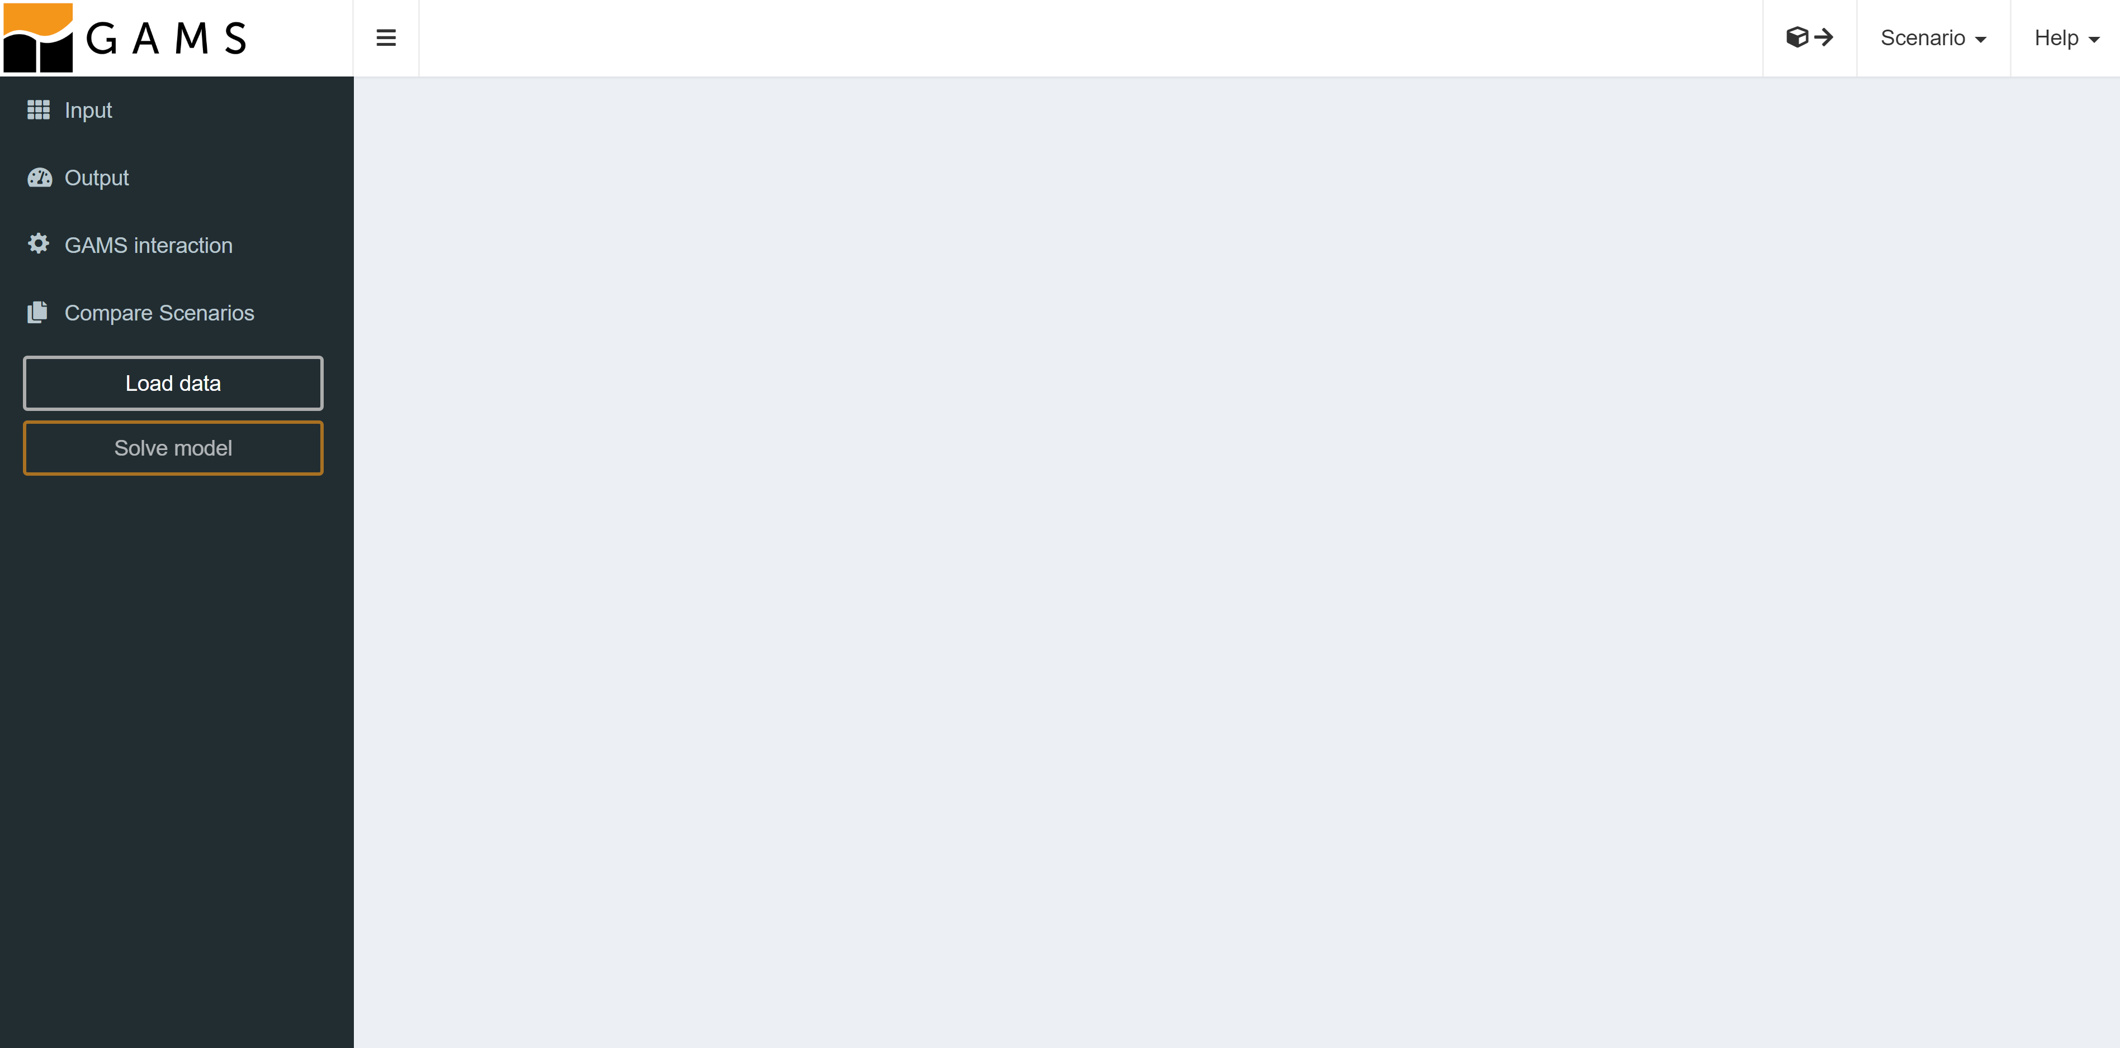

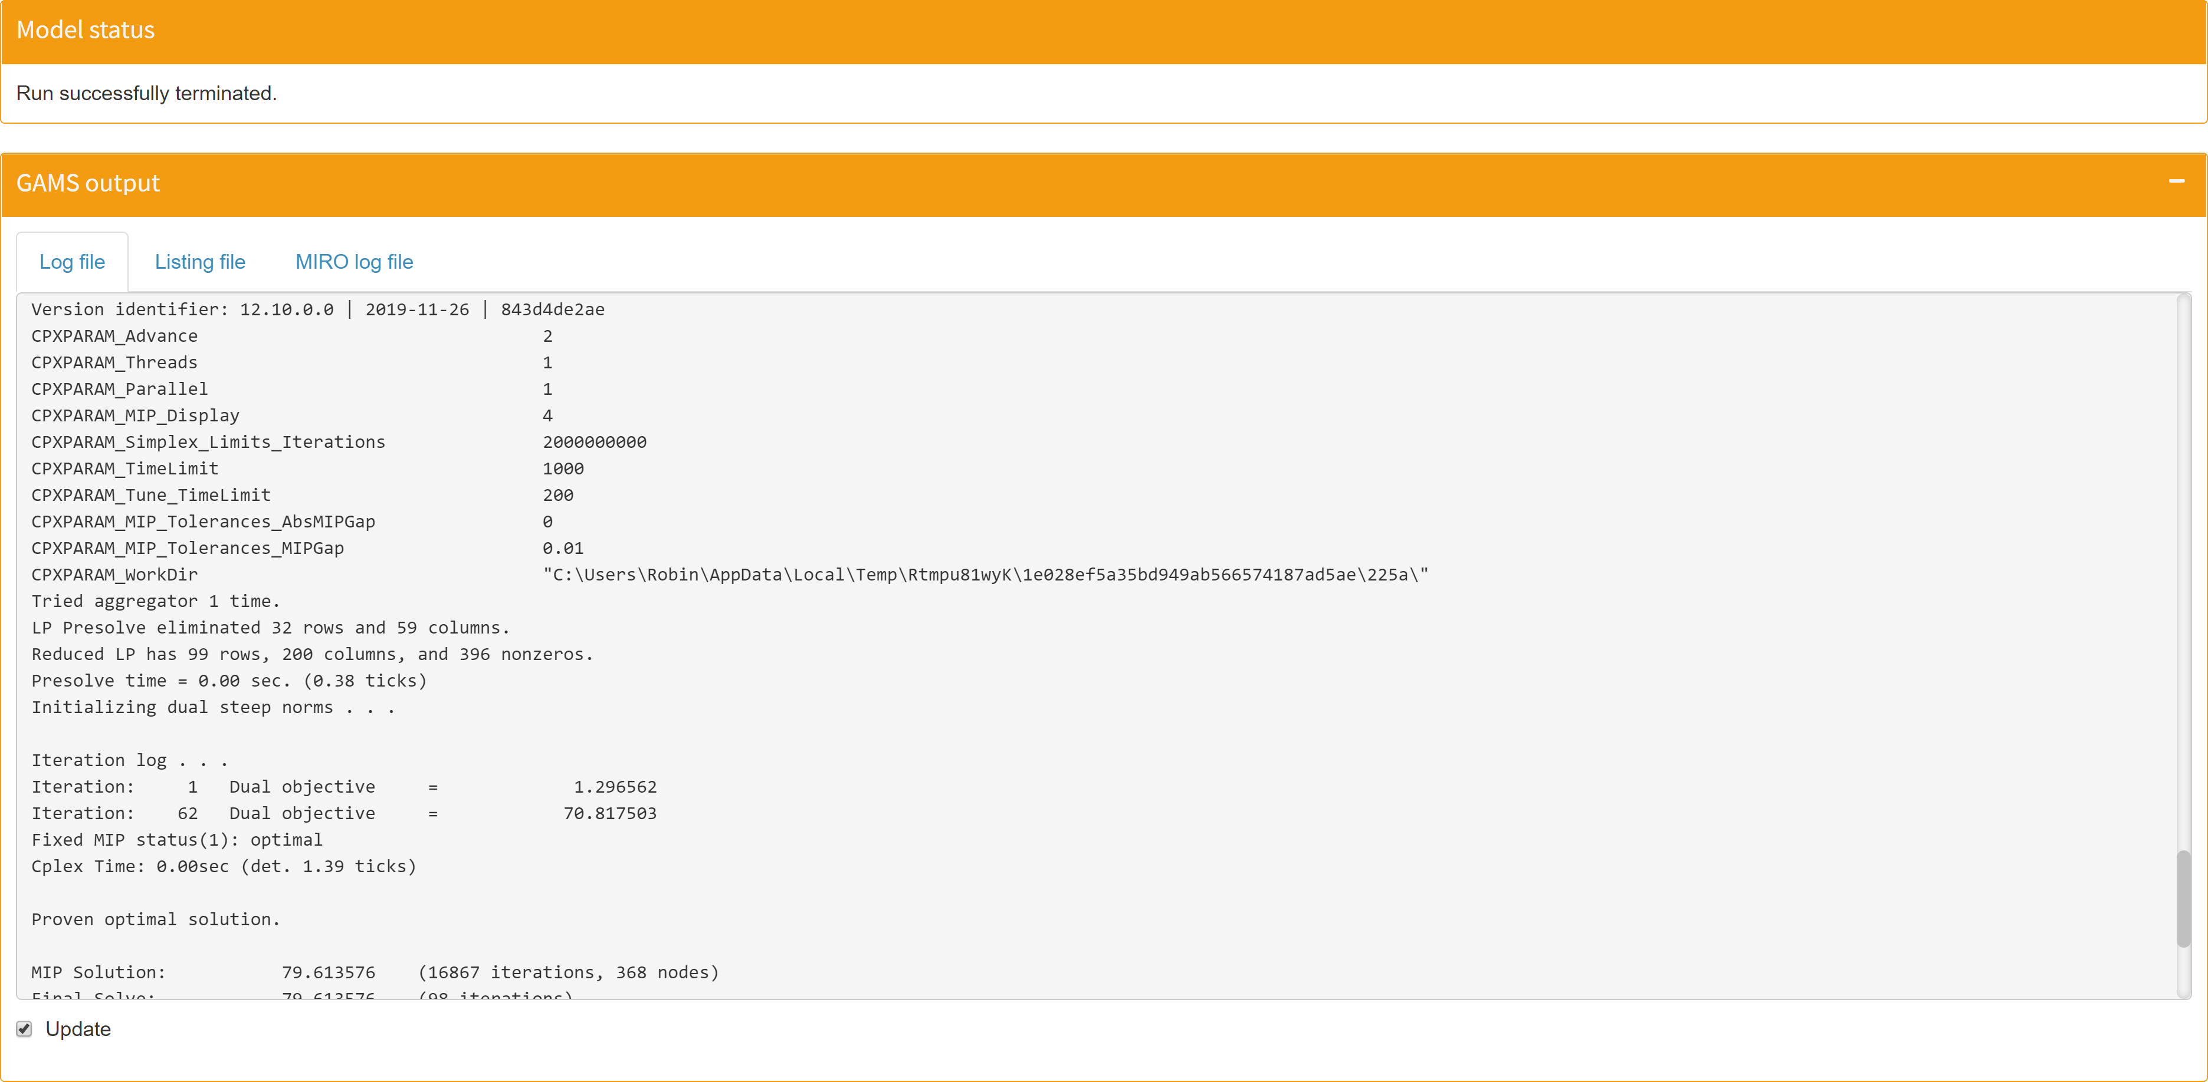
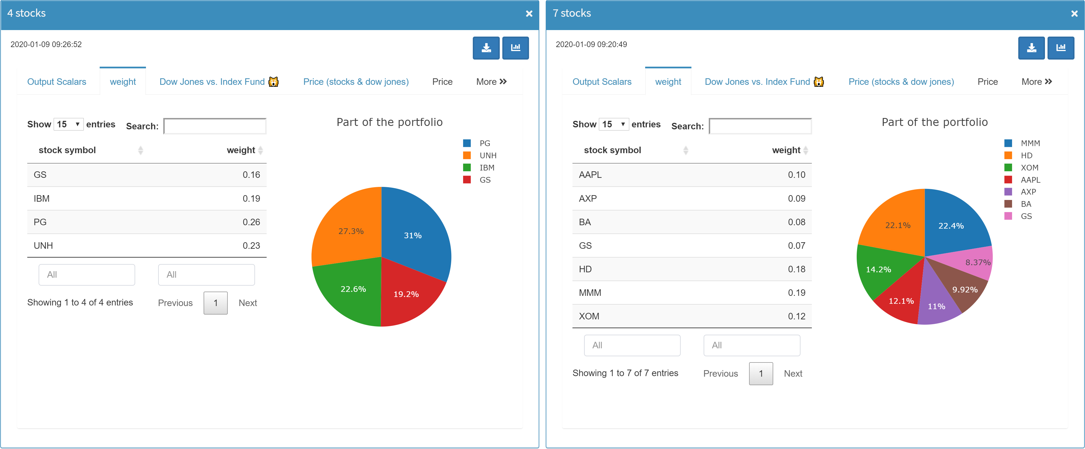
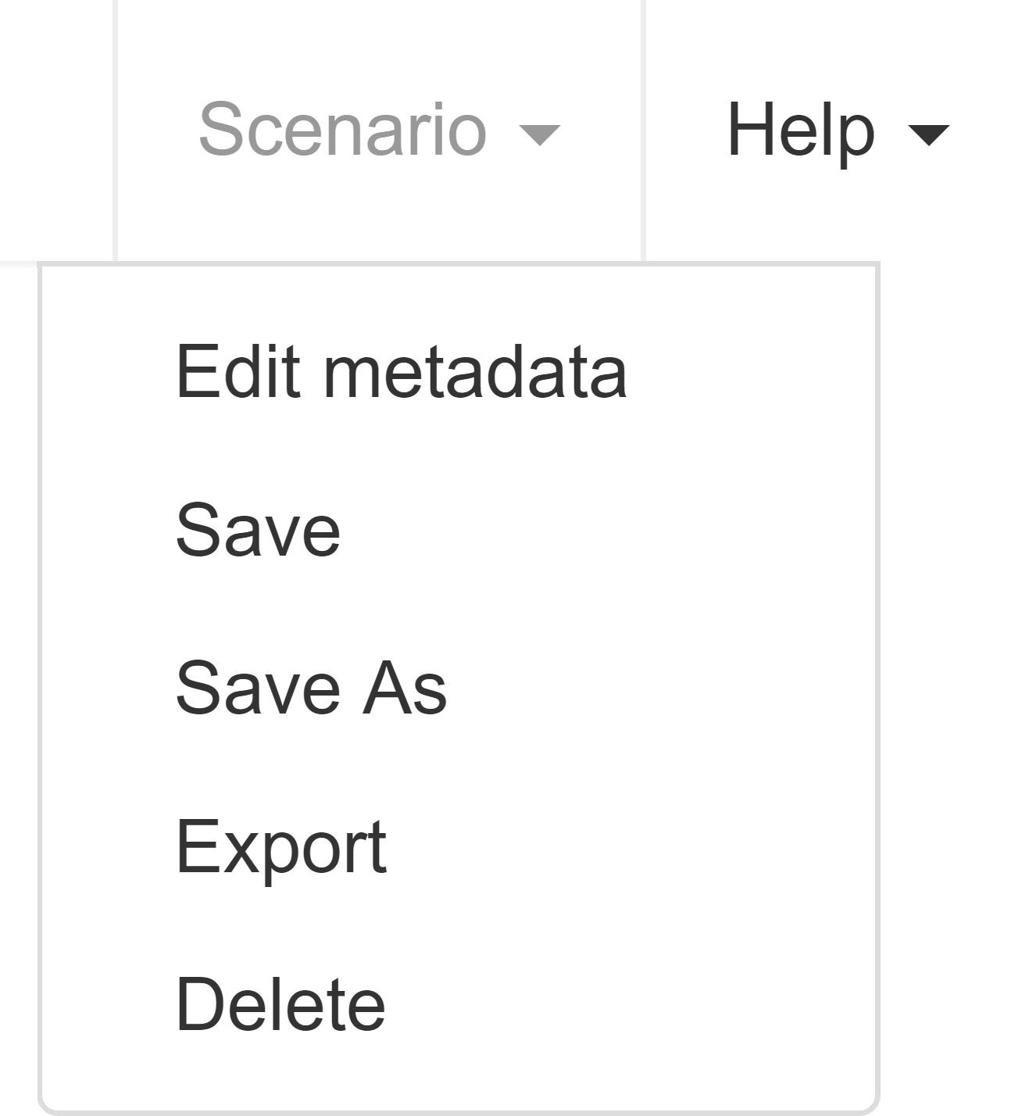
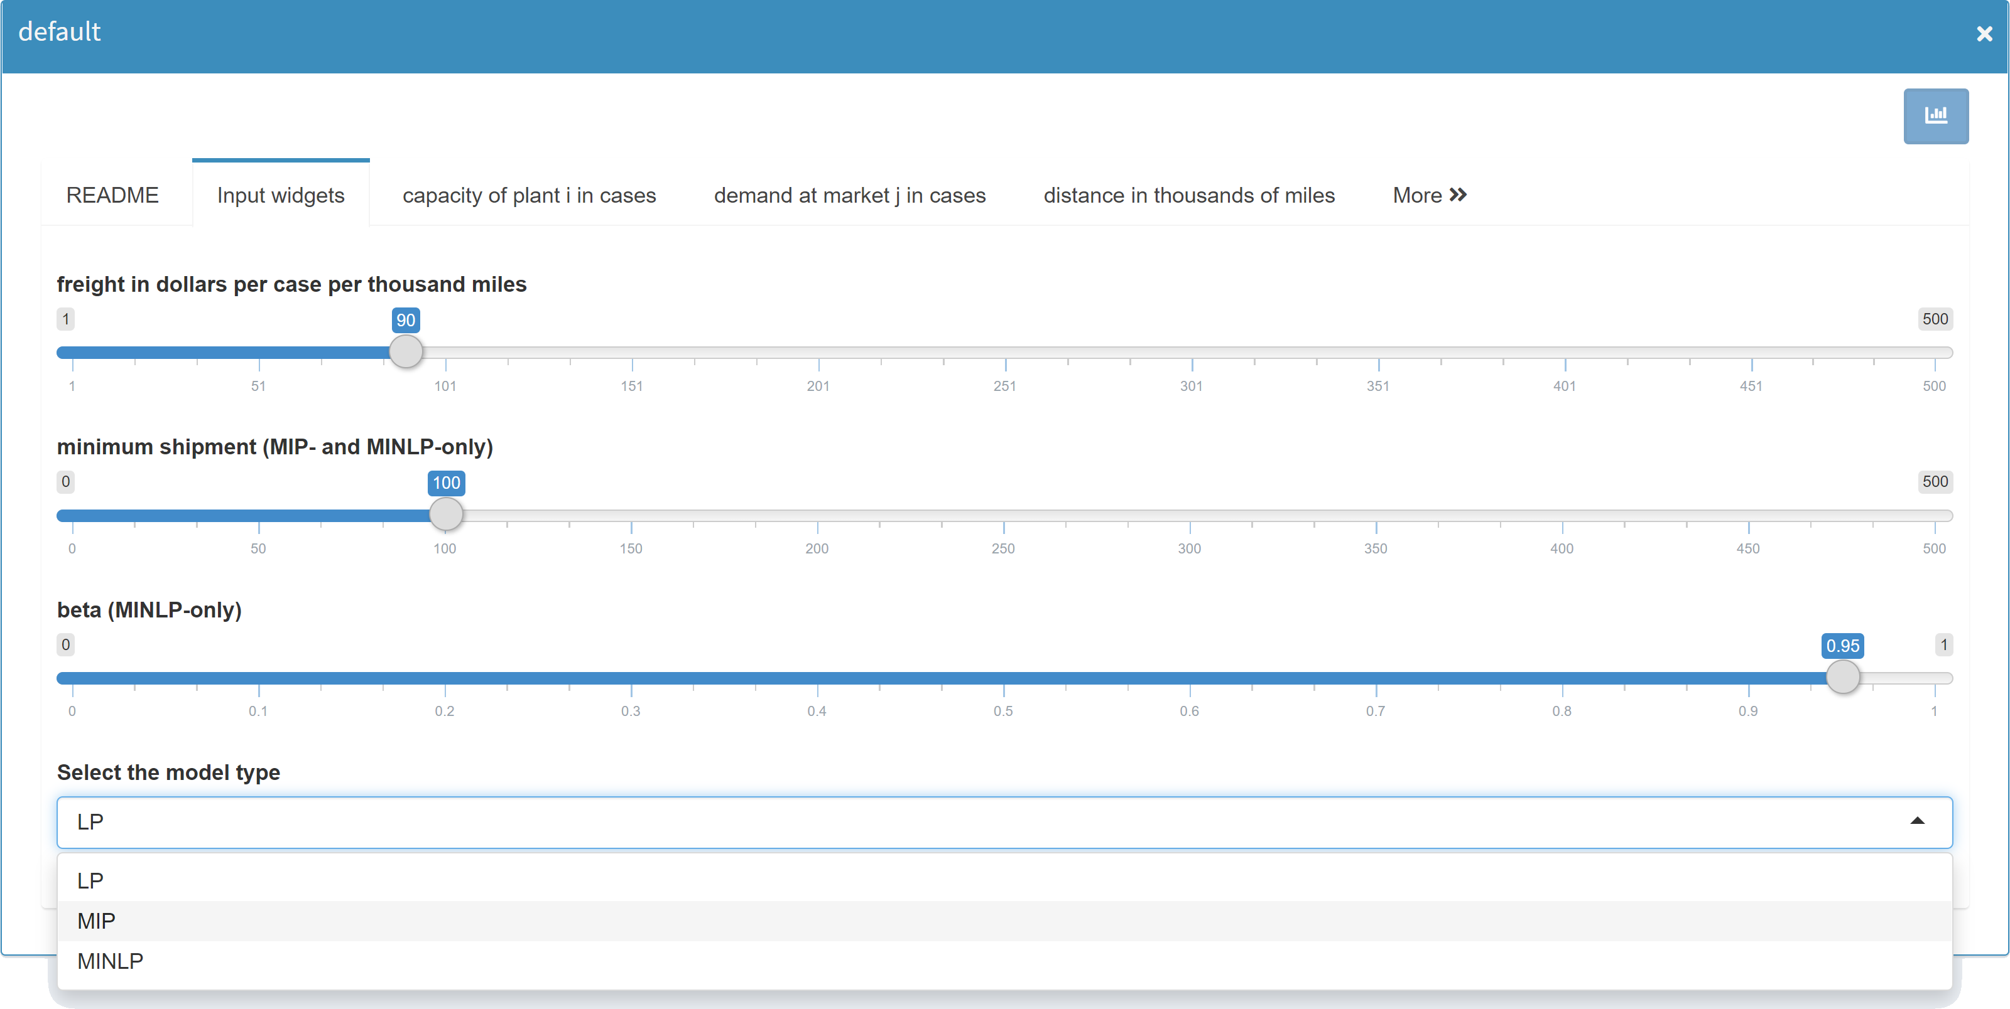
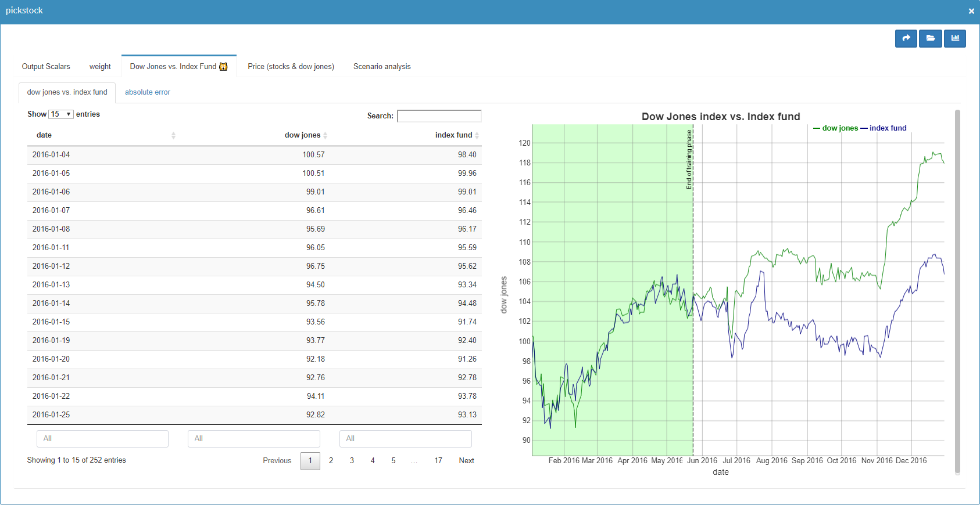
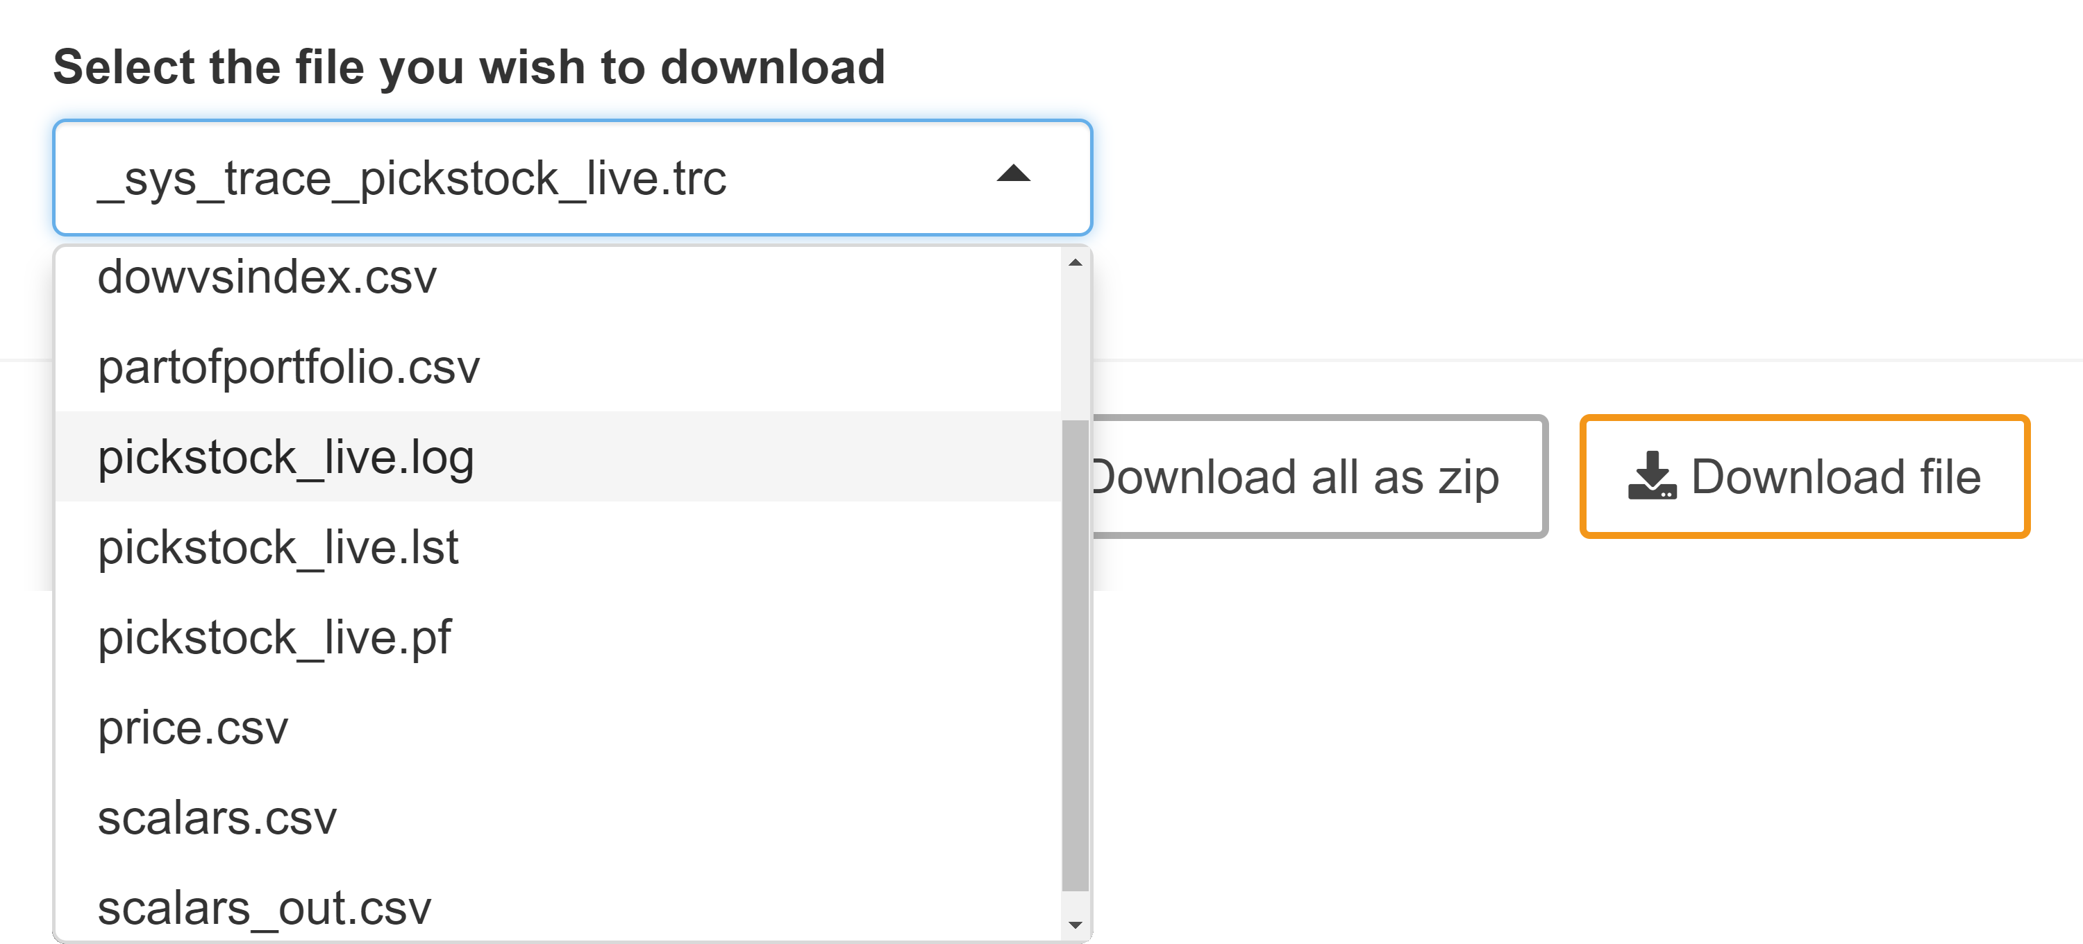
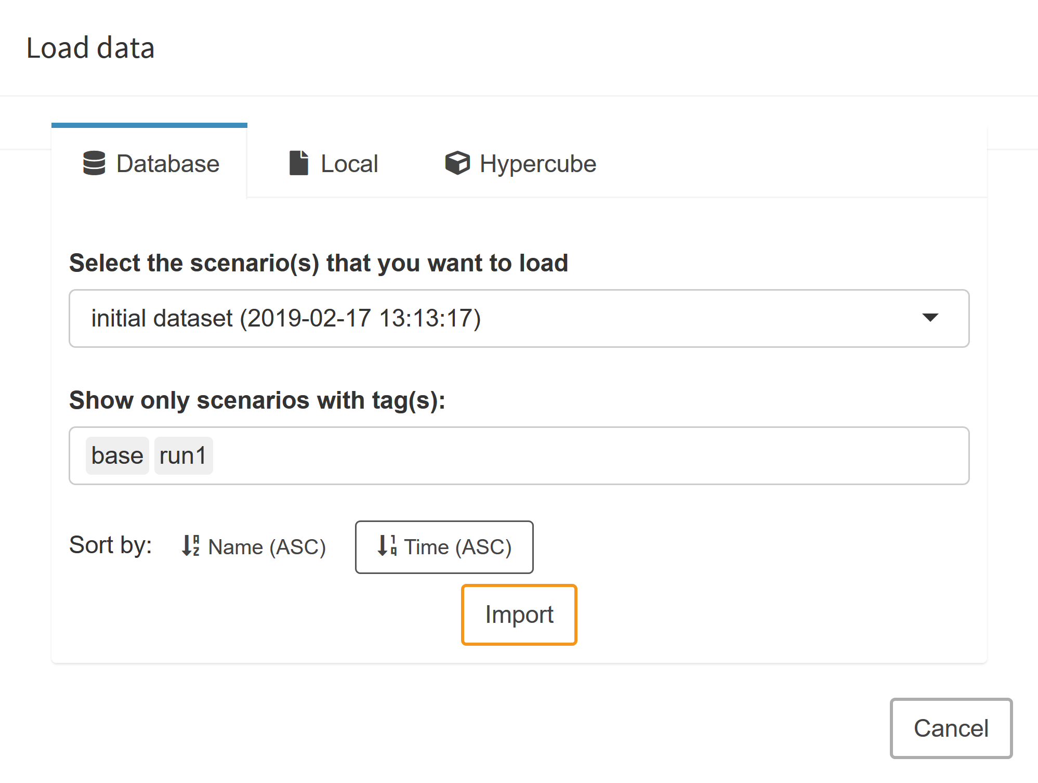
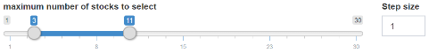
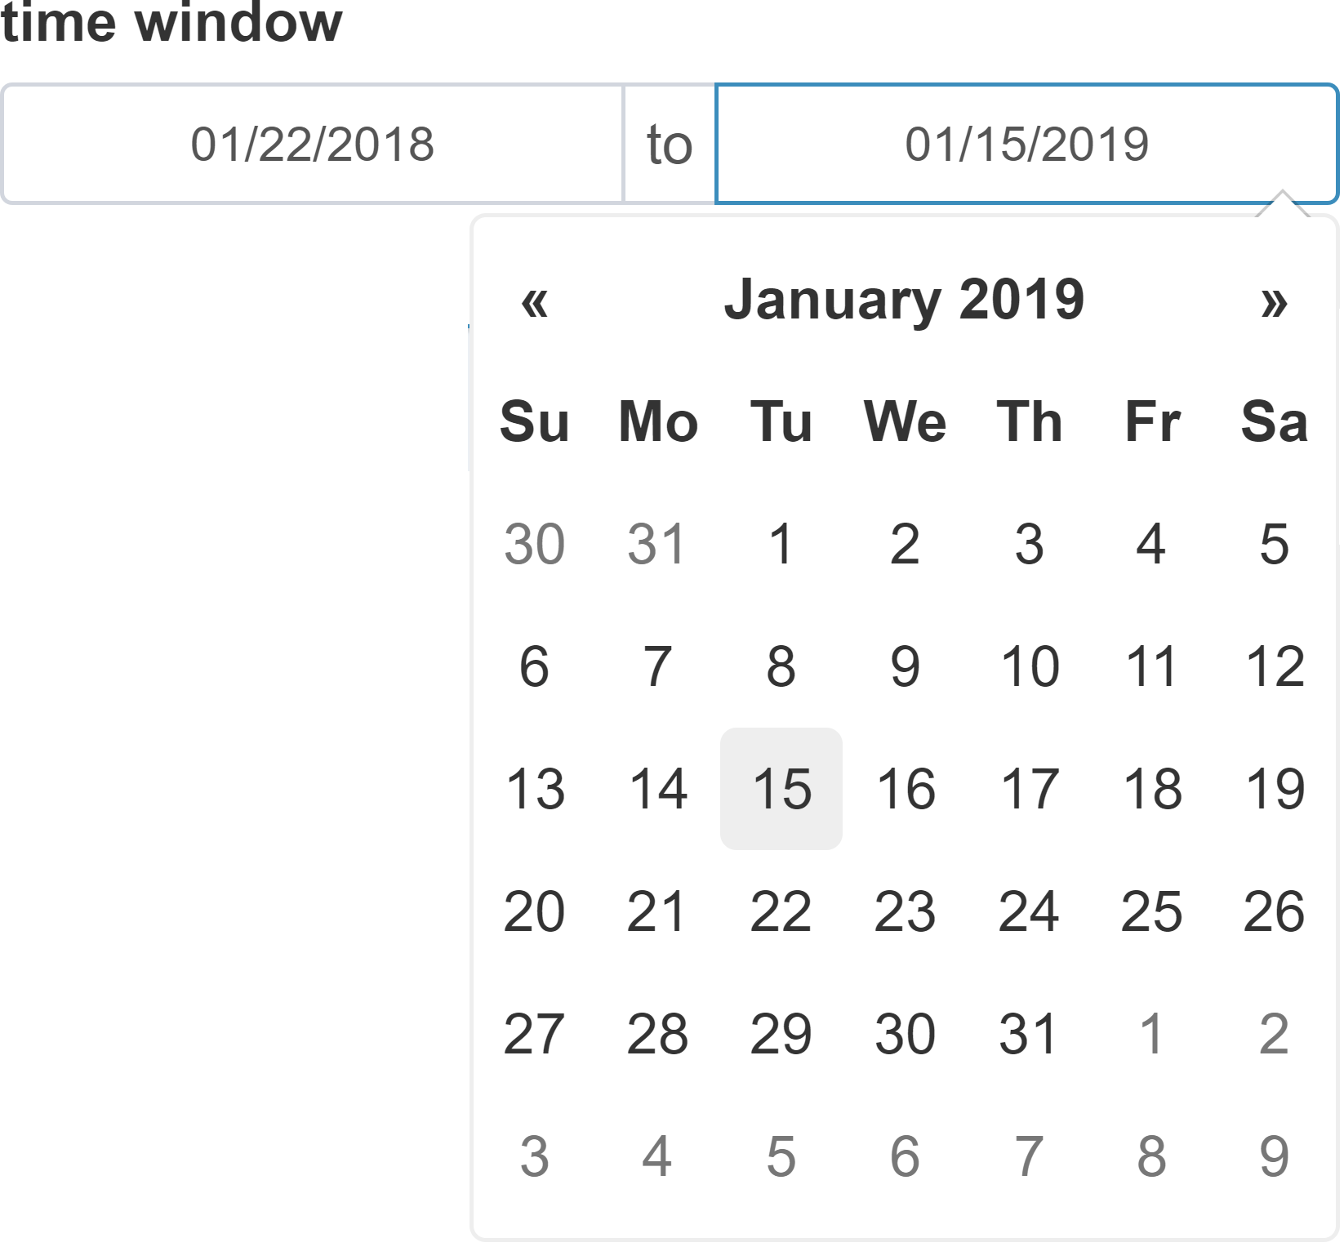
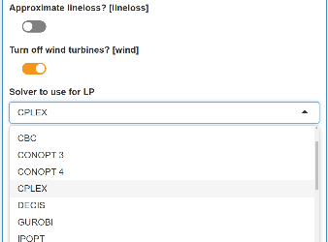
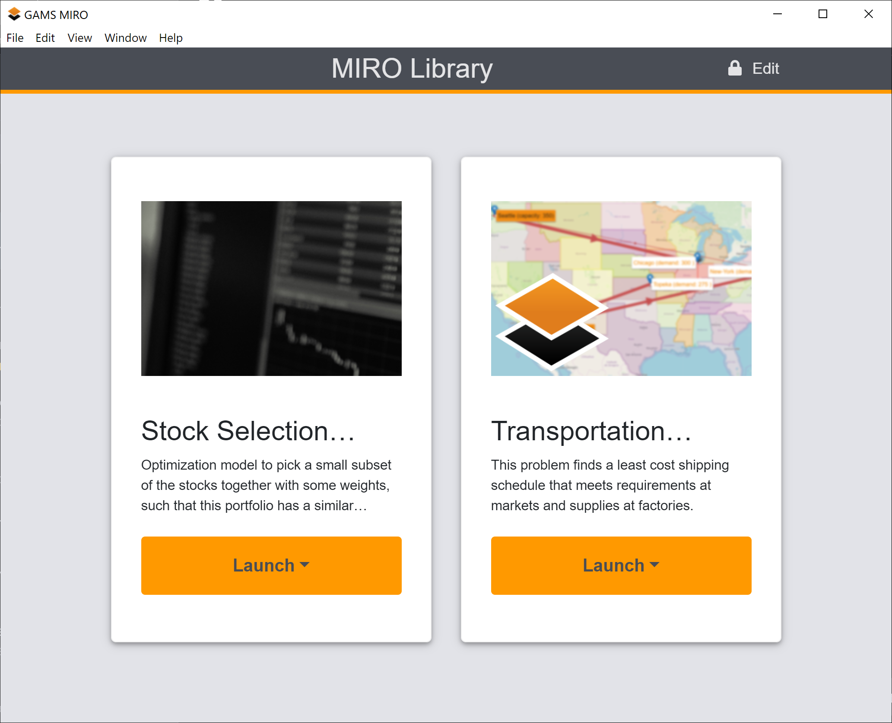
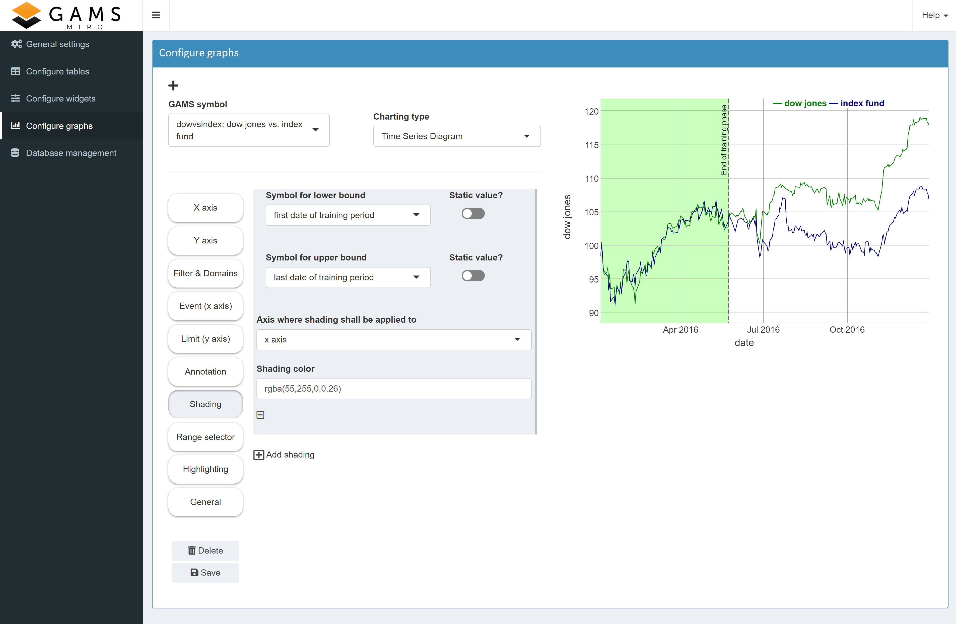
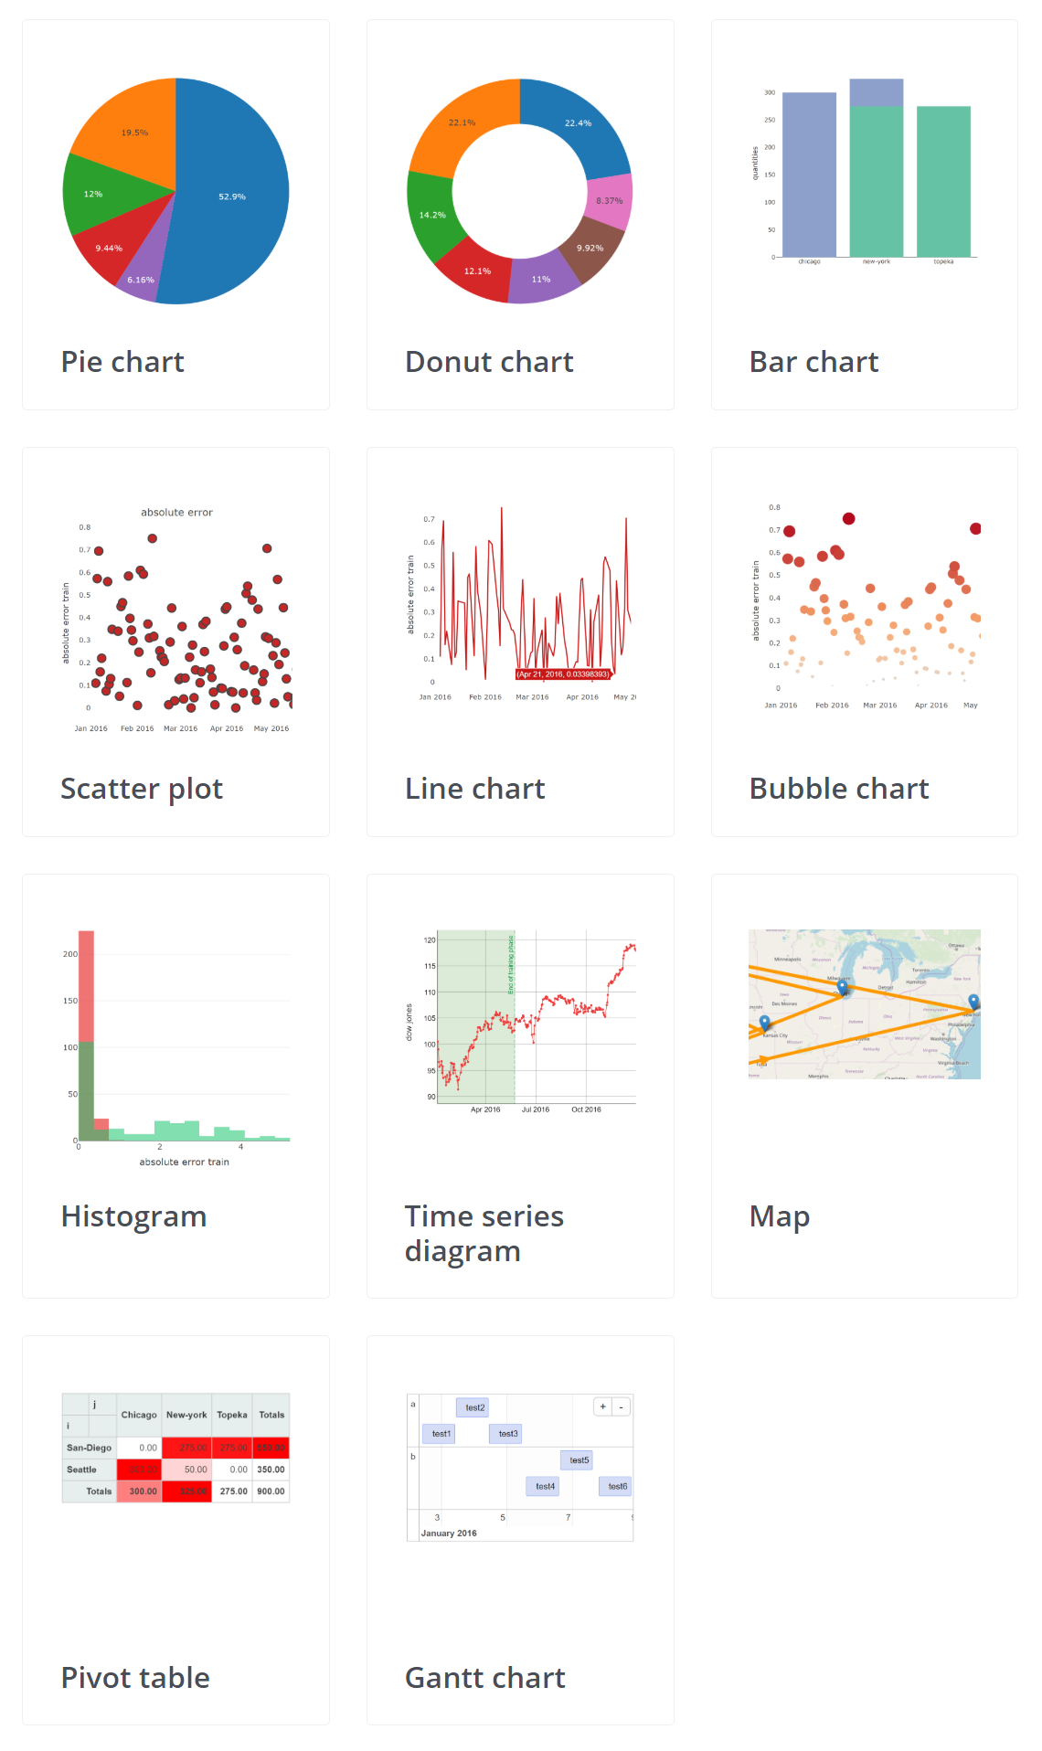
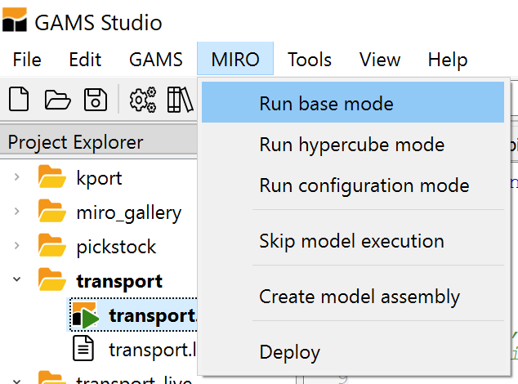
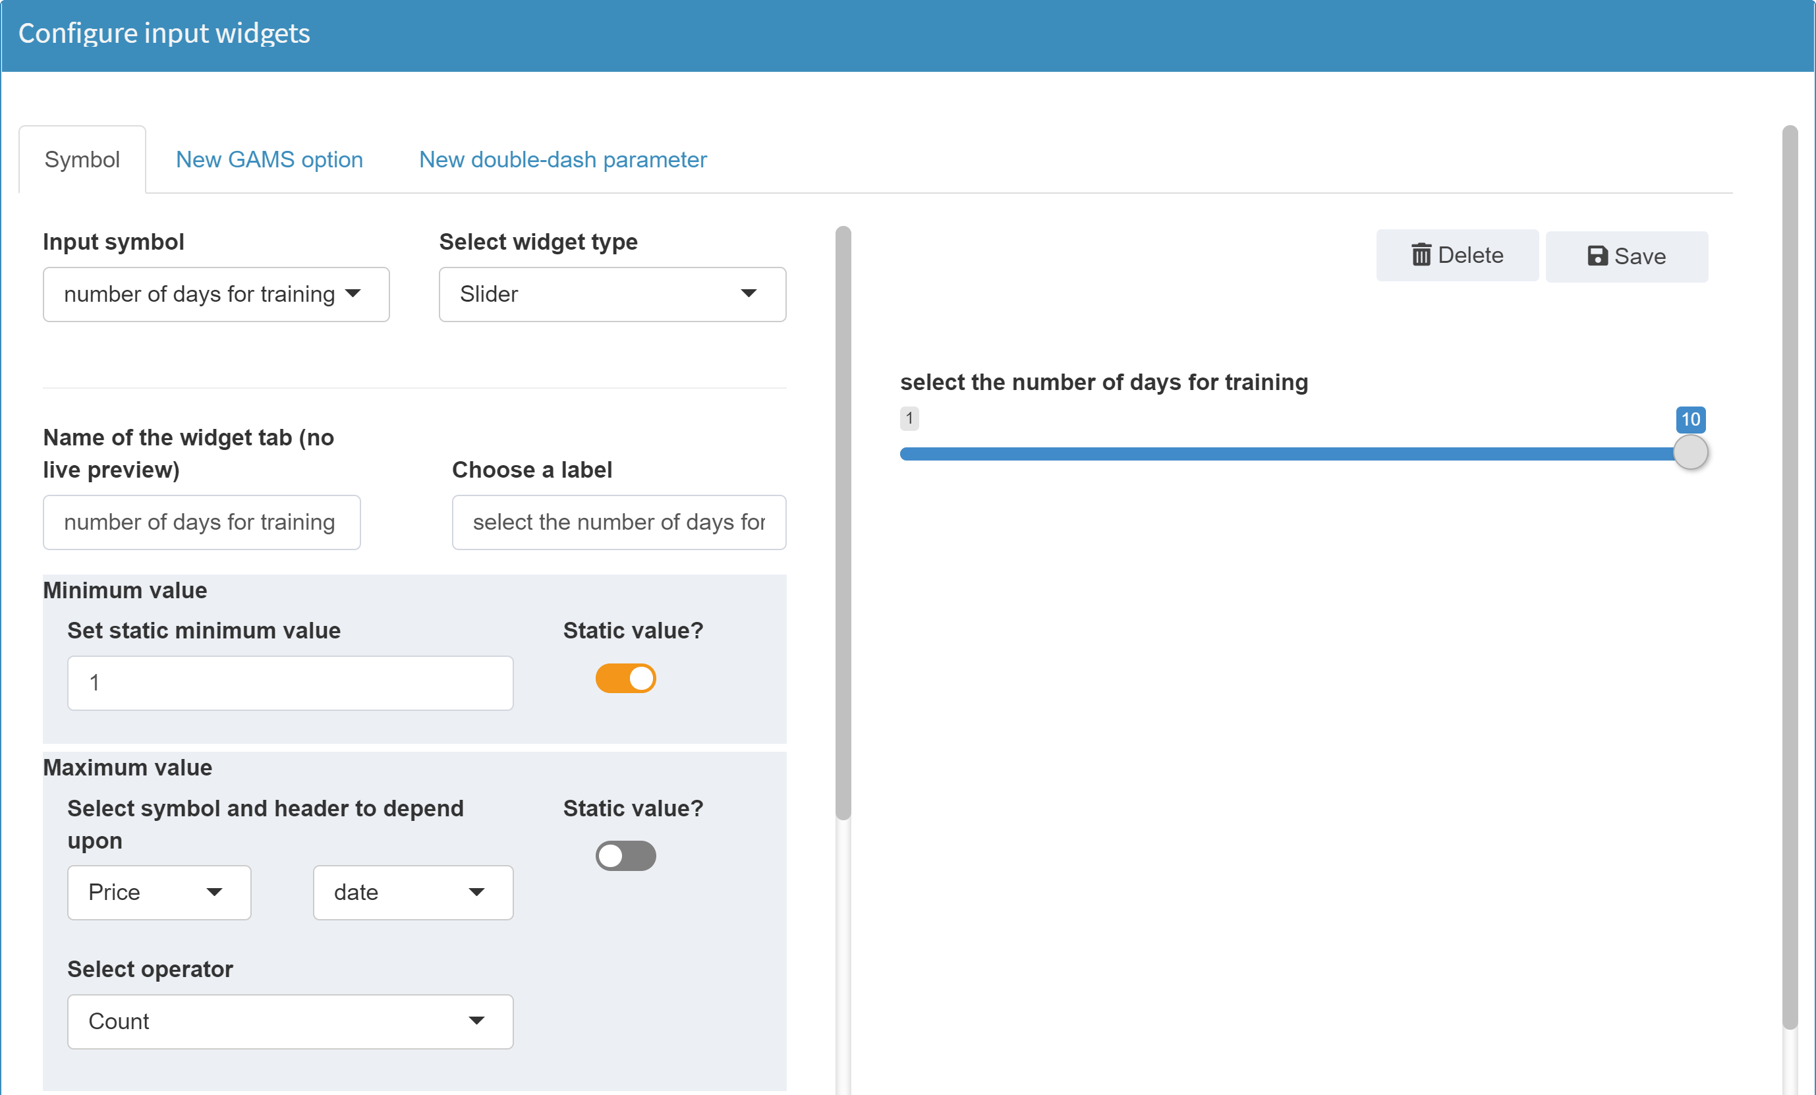
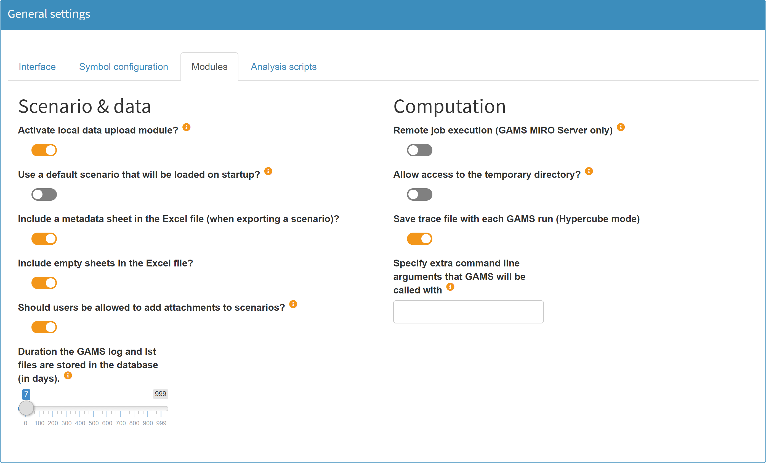
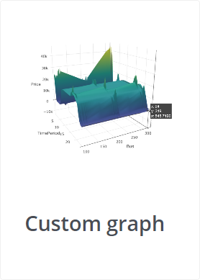
gams miro || cheat sheet
GAMS interaction
Compare Scenarios
Basics:
Customizable Logo
Direct access to GAMS and MIRO output files
Compare scenarios in split screen and tab-view
GAMS MIRO helps you turn your GAMS model into an interactive web application. It is an easy and automated way to deploy a GAMS model, and its extensive data and solution visualization capabilities allow you to produce and use optimization-based decisions with confidence.
Hide Sidebar
Model status message
Log file
Listing (lst) file
Download scenario data (gdx, xlsx, csv)
Show all entries
Documentation
GAMS World forum
About dialog
Custom log
Close scenario
Scenario management
UI – database interaction
Key features:
Save / save as
Edit scenario metadata
➞ Scenario name / tag
➞ File attachments
➞ Access permissions
Delete scenario
Export scenario data ➞ gdx, xlsx, csv
Quick & automated deployment of GAMS models
Data visualization with powerful graphics
Generation, processing and evaluation of scenario data
Intuitive, structured integration requires no GAMS expertise
Easy to use & comfortable working environment
Switch between graphical and tabular data representation
Load data
Download temporary files
All files of the working directory
Solution reports
GAMS Log & Lst file
[…]
Import data from database and/or local files
Internal database
XLSX/GDX/CSV
Import from Hypercube mode
Custom README file
Dropdown menu
Filter results
schematic overview
Use output data to populate input tables
Selected data set
Start / stop GAMS run
Input data tabs
Slider
(grouped) output data tabs
Table page navigation
Data and corresponding graph side by side or separated
Custom scenario analysis
Sort database entries
Input
Output
Scenario tags
Cancel Import
Visualization & configuration of input data for the next calculations
Visualization of results
How to get there
Model annotation
Configuration
Deployment
Enclose input data which should be visible in MIRO with $onExternalInput/$offExternalInput tags
Enclose output data which should be visible in MIRO with $onExternalOutput/$offExternalOutput tags
(Multiple use possible)
Configuration & customization via MIRO configuration mode
Available input widgets:
Slider / slider range
(Multi) dropdown menu
Date (range) selector
Checkbox
Text input / numeric input
Easy deployment of MIRO applications for end user in daily business
General appearance
Input widgets
Graphics
Table settings
Functionality
[…]
[…]
$onExternalInput
Parameters a(i) 'capacity of plant in cases' / seattle 350
san-diego 600 /
Scalar f 'freight in dollars per 1000 miles’ / 90 / ;
$offExternalInput
[…]
$onExternalOutput
Variables x(i,j) 'shipment quantities in cases'
z 'total transportation costs in 1000$’ ; $offExternalOutput
[…]
Solve transport using lp min z;
Available graph types:
Launch:
Via GAMS Studio
Via command line
configuration mode
Custom renderer via R API
GAMS Software GmbH
www.gams.com
info@gams.com
Learn more at www.gams.com/miro
GAMS MIRO version 1.0
Updated: 2020-01-09
base mode

Slide 2
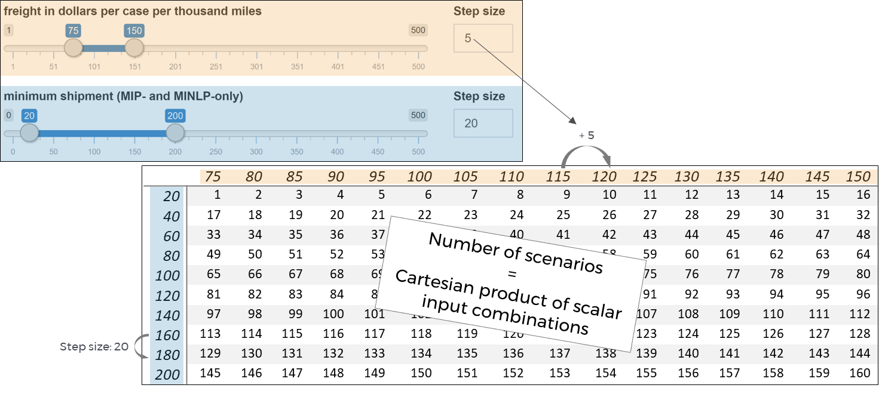

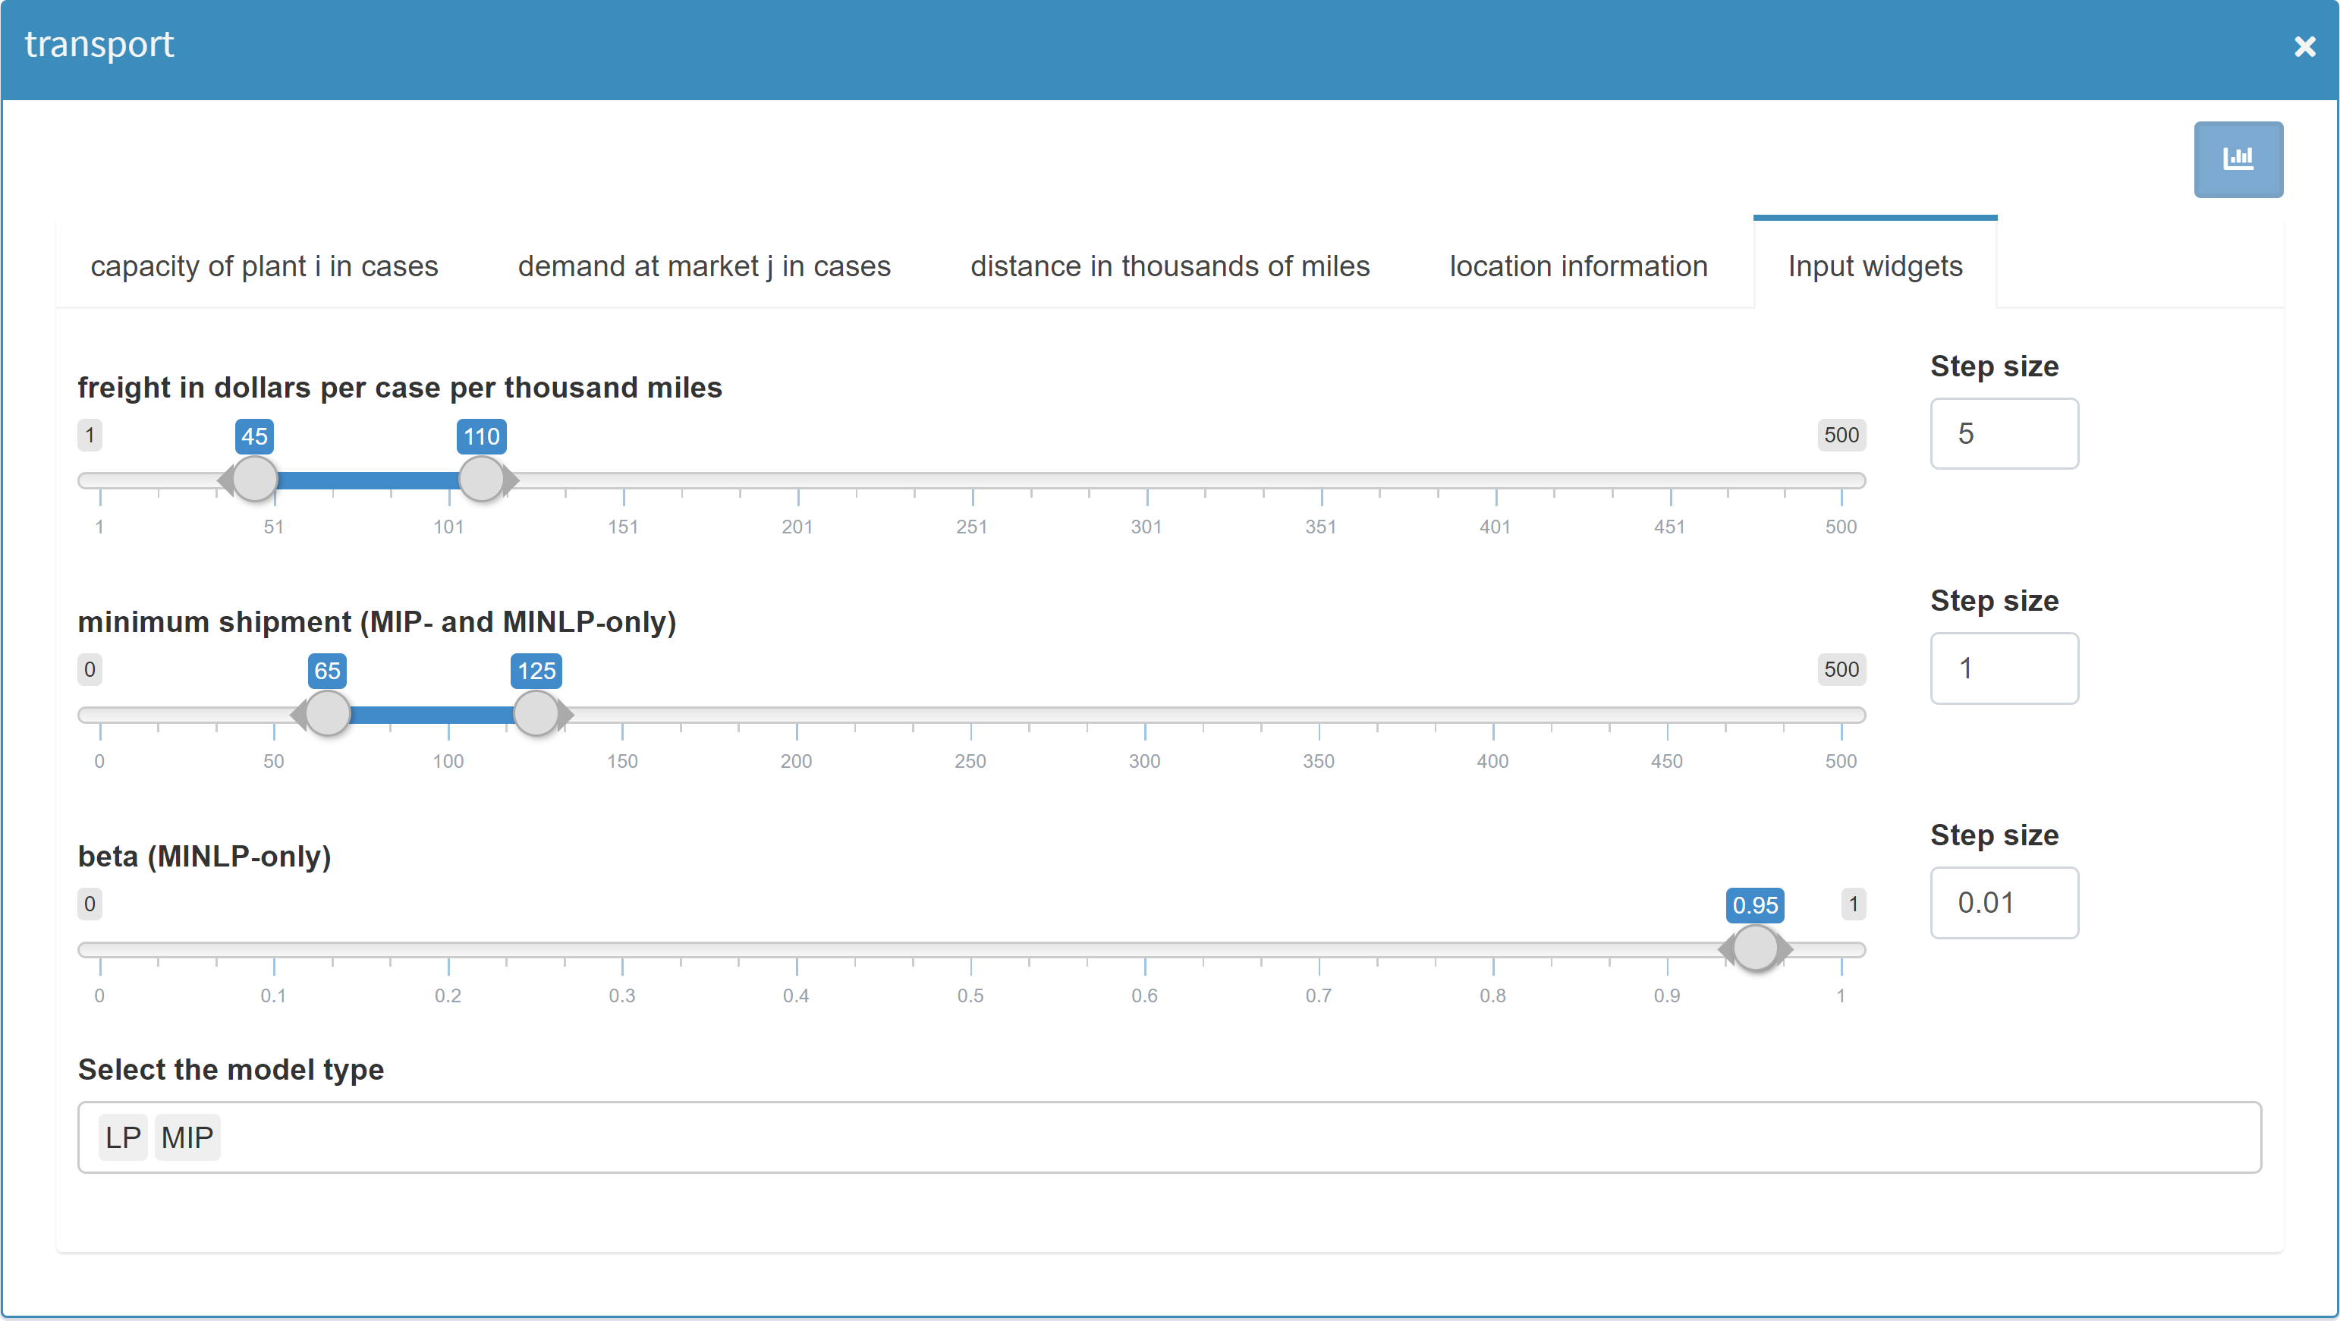
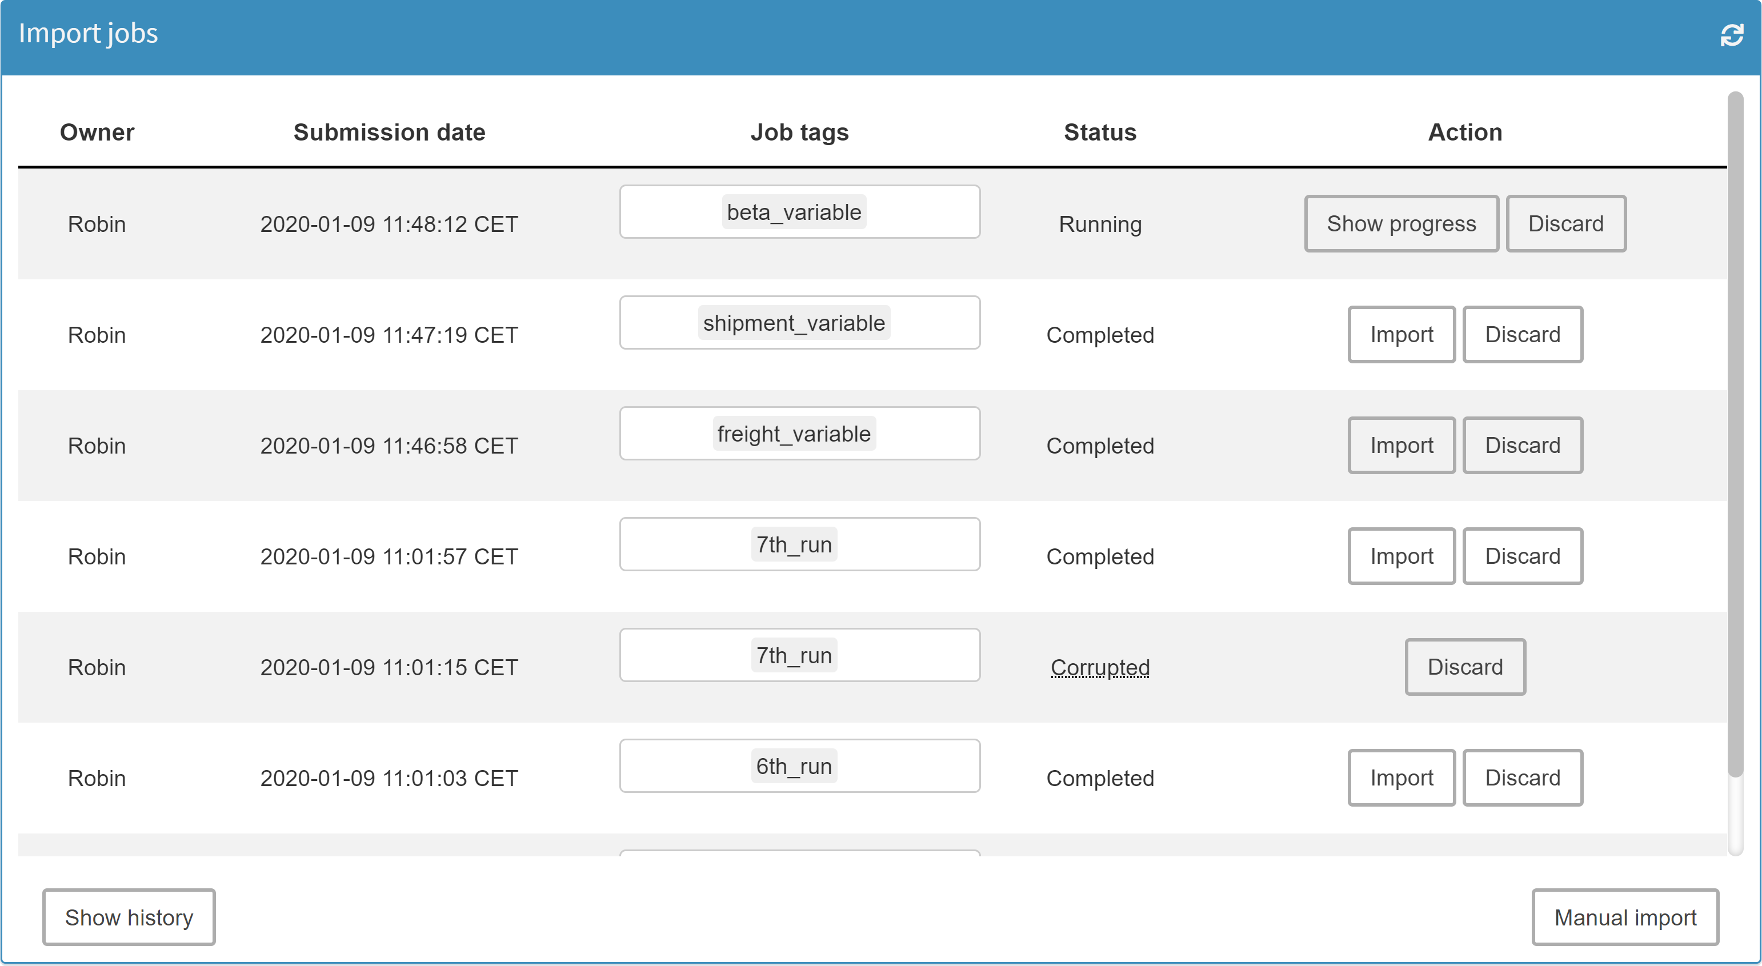
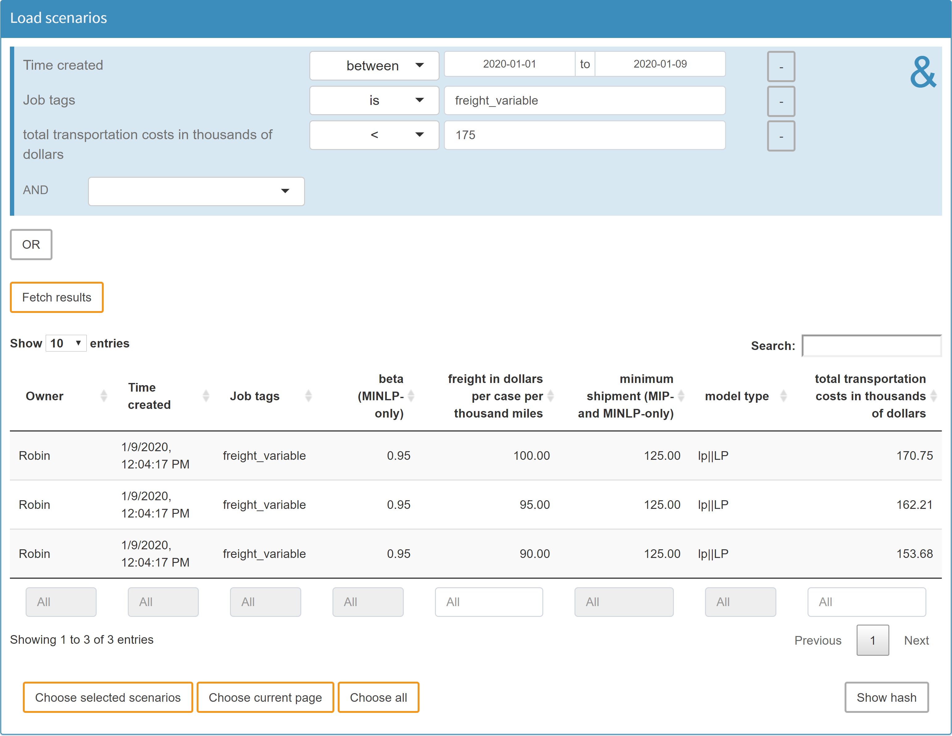
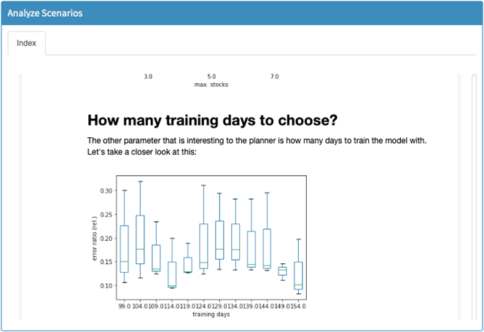
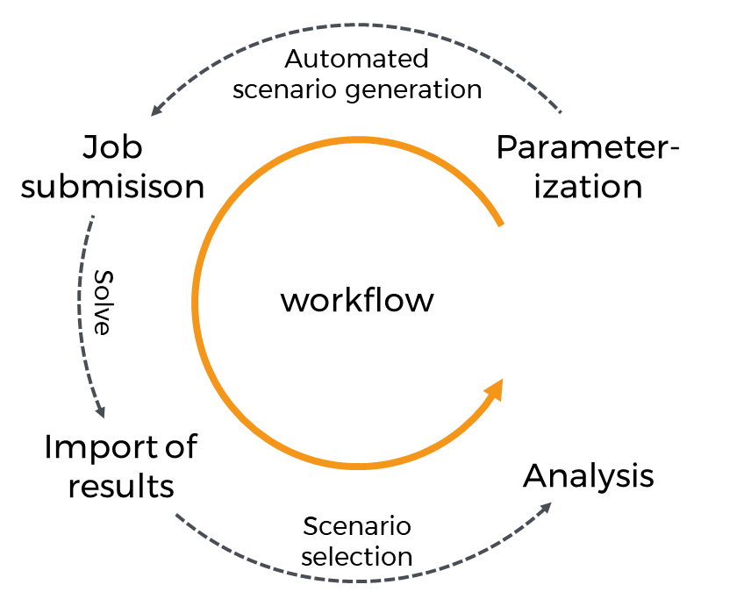
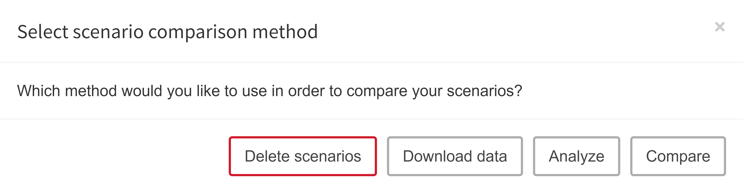
gams miro || cheat sheet
Scenario generation
Basics:
Key features:
Step size of slider range for scenario generation
The Hypercube mode was developed to perform scenario runs and (sensitivity) analyses. It allows to automatically generate, solve and analyze multiple data instances for a GAMS model at once.
Automated generation of multiple data instances
Instant check for duplicated instances
Easy and convenient data management
Generation of performance statistics and sensitivity analyses
Data export for external GAMS jobs and analyses
shortcuts
Simplified navigation through the user interface
Option | Shortcut
Confirm | ENTER
Close Pop up | ESC
Import | Ctrl + ALT + I
Solve | Ctrl + ALT + ENTER
Save | Ctrl + ALT + S
Save as | Ctrl + ALT + S
Remove | Ctrl + ALT + R
Close | Ctrl + ALT + C
Hide sidebar | Ctrl + ALT + F
“Input” (sidebar) | Ctrl + ALT + 1
“Output” (sidebar) | Ctrl + ALT + 2
“GAMS interaction” (sidebar) | Ctrl + ALT + 3
“Compare scenarios” (sidebar) | Ctrl + ALT + 4
“Configure Hypercube job” (sidebar) | Ctrl + ALT + 1
“Import results” (sidebar) | Ctrl + ALT + 2
“Load results” (sidebar) | Ctrl + ALT + 3
“Compare scenarios” (sidebar) | Ctrl + ALT + 4
“Analyze scenarios” (sidebar) | Ctrl + ALT + 5
Table view (section scenario compare) | Ctrl + ALT + T
Select next tab (table view) | Ctrl + ALT + arrow right
Select precious tab (table view) | Ctrl + ALT + arrow left
Nest to next lower tab menu | Ctrl + ALT + arrow down
Unnest to next higher tab menu | Ctrl + ALT + arrow up
Activate / deactivate comparison mode | Ctrl + ALT + space
Compare scenarios
Configure Hypercube job
Import results
Same scenario comparison as in
➞ base mode
Creation of multiple scenario parameterizations
Scalar input data
Add, edit, delete job tag(s)
Overview and import of submitted Hypercube jobs
Base mode: single dropdown
Hypercube mode: multi dropdown
Base mode: single slider
Hypercube mode: slider range
Import calculated scenarios
Show process of job calculations
Discard Hypercube job
refresh
Boolean AND / OR
“Slice & dice” scenarios in database
Automated/manual Hypercube job submission
Query database
Show job history
Manual scenario import
Import data (local file, database or data from base mode)
Search results
Show hash value of selected scenario
schematic overview
Choose scenarios for analysis, download, deletion
Custom scenario analysis
Load results
Analyze scenarios
Graphical database query. Slice & dice the database to fetch scenarios.
For custom scenario analysis and/or integrated performance analysis tool PAVER
Delete selected scenarios
Compare scenarios in split / tab view
GAMS Software GmbH
www.gams.com
info@gams.com
Learn more at www.gams.com/miro
GAMS MIRO version 1.0
Updated: 2020-01-09
Download scenario data (e.g. for external analysis)
Custom scenario analysis
Analyze scenarios with PAVER
hypercube mode

